Slide 1
FIRST-AID DICTIONARY

Slide 2
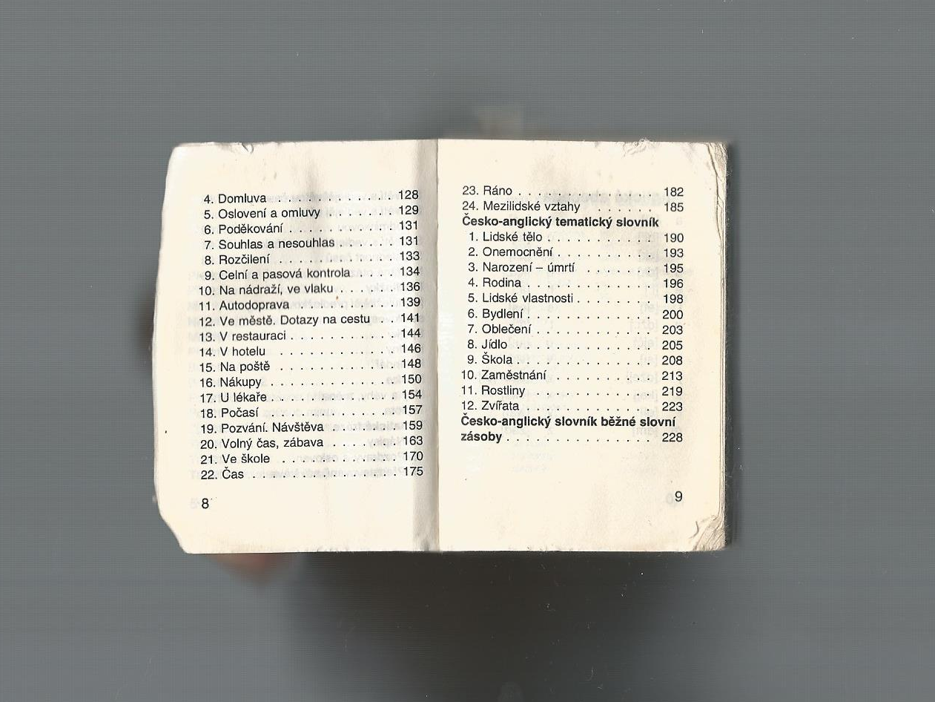

Slide 3
Basic pharses
Symptoms and health
Accidents
Time
TOPICS
In the street
At hotel
Traffic
In the restaurant

Slide 4
